Slide 1
In the name of god
Subject : Lesson One of English eighth
START

Slide 2
List
Conversation
Practice
Spelling
words

Slide 3
Conversation
Shayan:Mr. Chaychi, this is my cousin Sam. He speaks French,
English, and a little Persian.
Teacher:Oh, nice to meet you, Sam.
Sam:Nice to meet you, too.
Teacher:Are you from Iran?
Sam:Yes, I’m originally Iranian, but I live in France.
Teacher:Welcome to our class. How do you like it in Iran?
Sam:Iran is great! I love it. It’s a beautiful country.
Sound
back
Play
stop
ترجمه

Slide 4
ترجمه متن درس
شایان : آقای چایچی ، این پسر عموی من سام است. او فرانسه صحبت می کند ، انگلیسی، و کمی فارسی معلم : از آشنایی با شما خوشحال شدم.
سام : من هم از آشنایی با شما خوش حال شدم
معلم : آیا تو ایرانی هستی؟
سام : اصلیت من ایرانی است ولی در فرانسه زندگی می کنم.
معلم : به کلاس ما خوش آمدی.آیا تو ایران را دوست داری؟
سام : ایران فوق العاده است! من آن را دوست دارم . ایرانن کشور زیبایی است.
back
back to list

Slide 5
Practice 1
Are you from Iran?
Are you from France?
Is she/he from England?
Is she/he from China?
Are they from Spain?
Are they from Brazil?
Yes, I am. / Yes, we are.
No, I’m not. / No, we’re not.
Yes, she/he is.
No, she/he isn’t.
Yes, they are.
No, they aren’t.
Practice 1
Practice 2
Practice 3
back

Slide 6
Practice 2
Are you Iranian?
Are you French?
Is she/he British?
Is she/he Chinese?
Are they Spanish?
Are they Brazilian?
Yes, I am. / Yes, we are.
No, I’m not. / No, we’re not.
Yes, she/he is.
No, she/he isn’t.
Yes, they are.
No, they aren’t.
Practice 1
Practice 2
Practice 3
back

Slide 7
Practice 3
Where are you from?
Where is Mary /she from?
Where is Mark /he from?
Where are they from?
(I’m /We’re from) Iran.
(She’s from) England.
(He’s from) France.
(They’re from) Spain.
Practice 1
Practice 2
Practice 3
back

Slide 8
Spelling
Student 1: How do you spell “chair”?
Student 2: That’s C-H-A-I-R.
Student 1: And which is correct for کفشin English, S-H-O-O-S or S-H-O-E-S?
Student 2: S-H-O-E-S.
Student 1: Thanks.
Sound
back
Play
stop

Slide 9
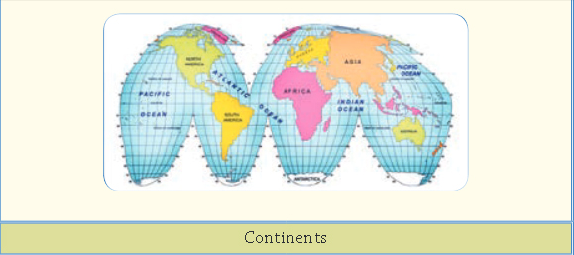
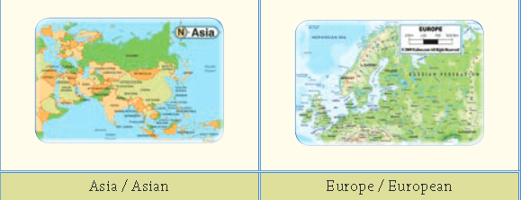
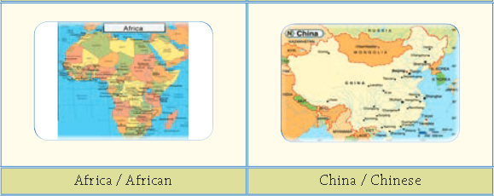
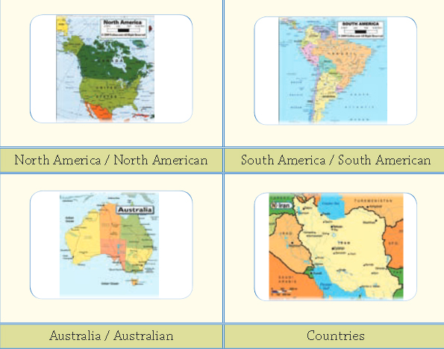
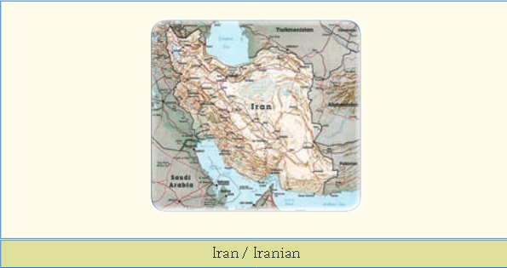
1
words
2
3
4
5
6
7
10
8
9
Sound
back
Play
stop

